Slide 1
AME20216 - Lab I Intro to Probability

Slide 2
Single Pendulum
One degree of freedom: θ
Balance Torque:
Damped harmonic oscillator

Slide 3
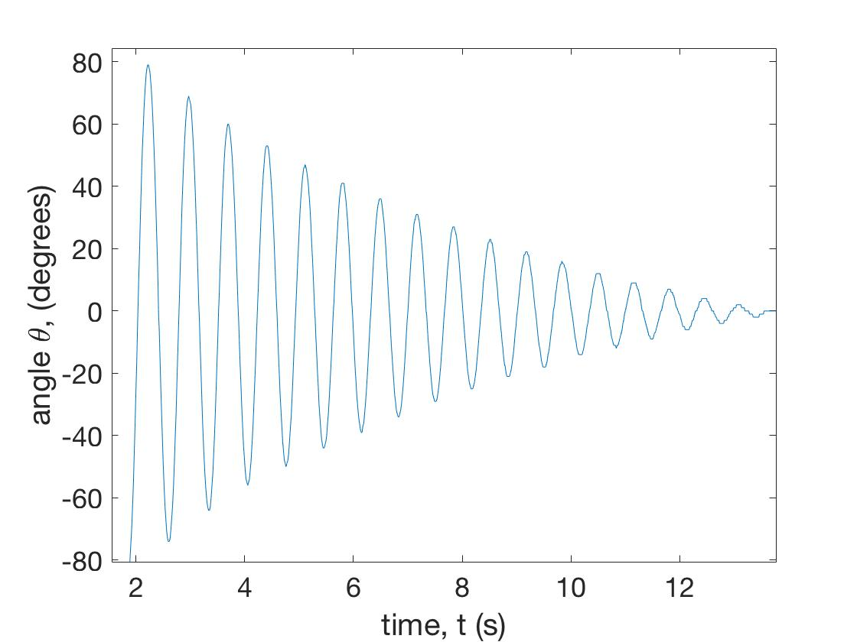
Single Pendulum: Predictable motion
Damped harmonic oscillator

Slide 4
Double pendulum: Chaotic motion
Two degrees of freedom: θ₁ and θ₂ .

Slide 5
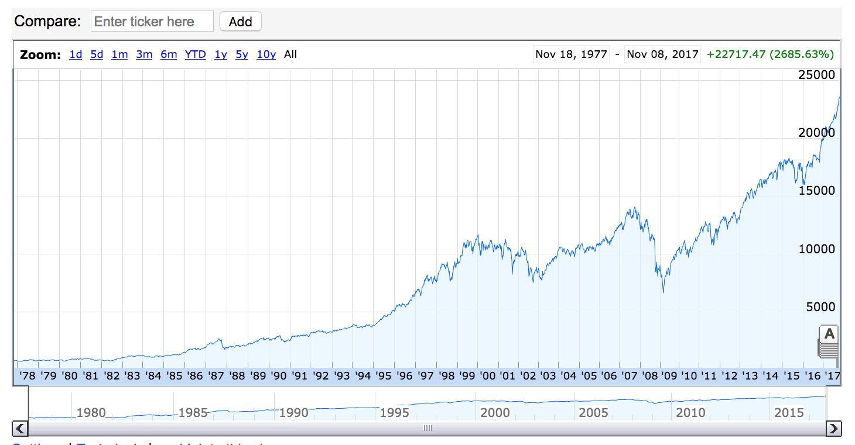
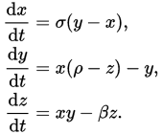
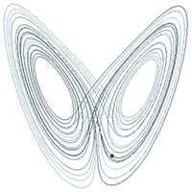
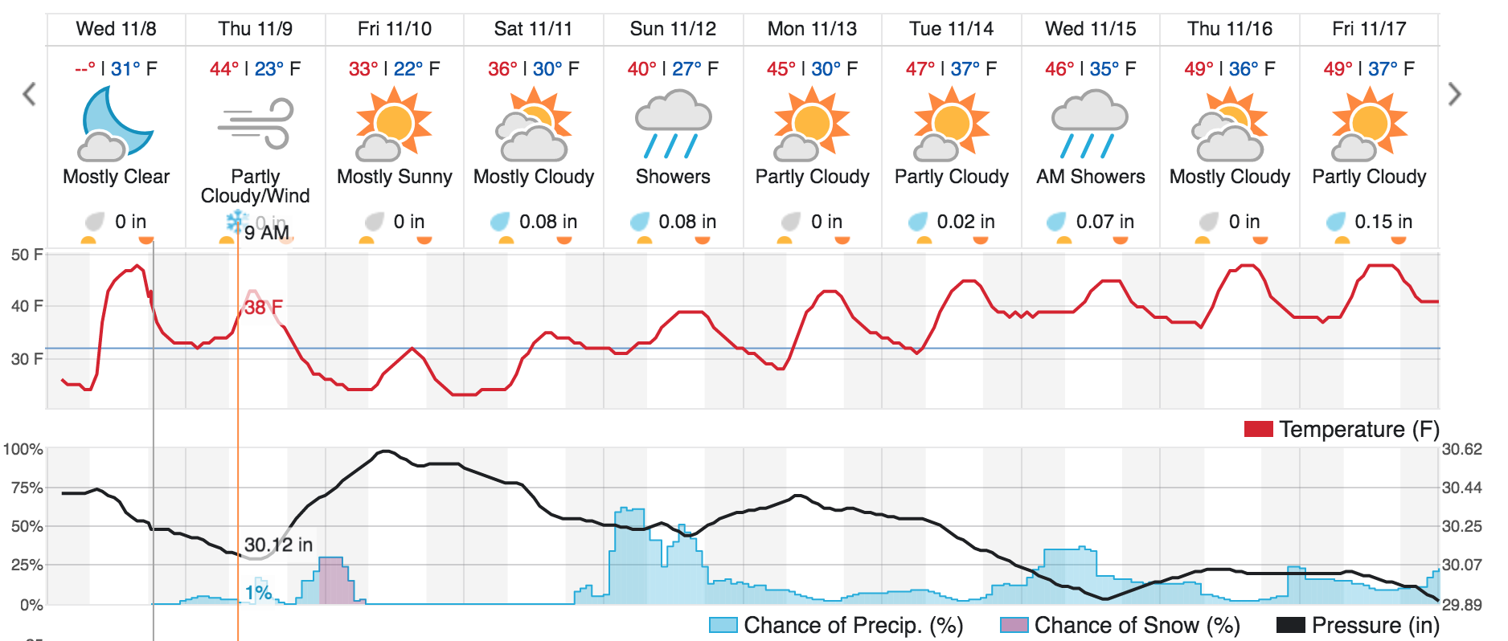
Chaos!
Complex systems are extremely sensitive to initial conditions.

Slide 6

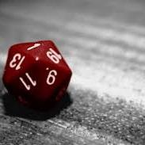
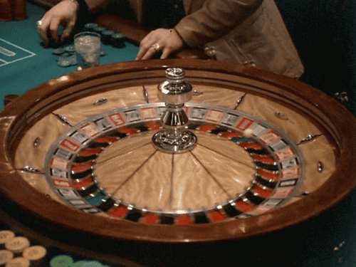

Unpredictable Systems

